Slide 1

Load Balancing

Slide 2

Overview
What is load balancing?
Why use a load balancer?
Health Checks
Types of Balancers
Sticky sessions
Cross Zone load Balancing
Connection Draining

Slide 3
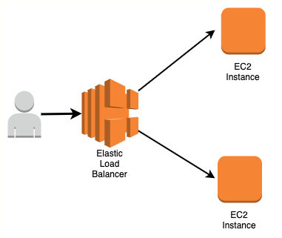
What is load balancing?
Load balances are servers that forward traffic to multiple servers(e.g. EC2 instances) downstream

Slide 4
Why use a load balancer?
Spread load across multiple downstream instances
Expose a single point access(DNS) to your application
Do regular health checks to your instances
Enforce stickiness with cookies
High availability across zones
Separate public traffic from private traffic

Slide 5
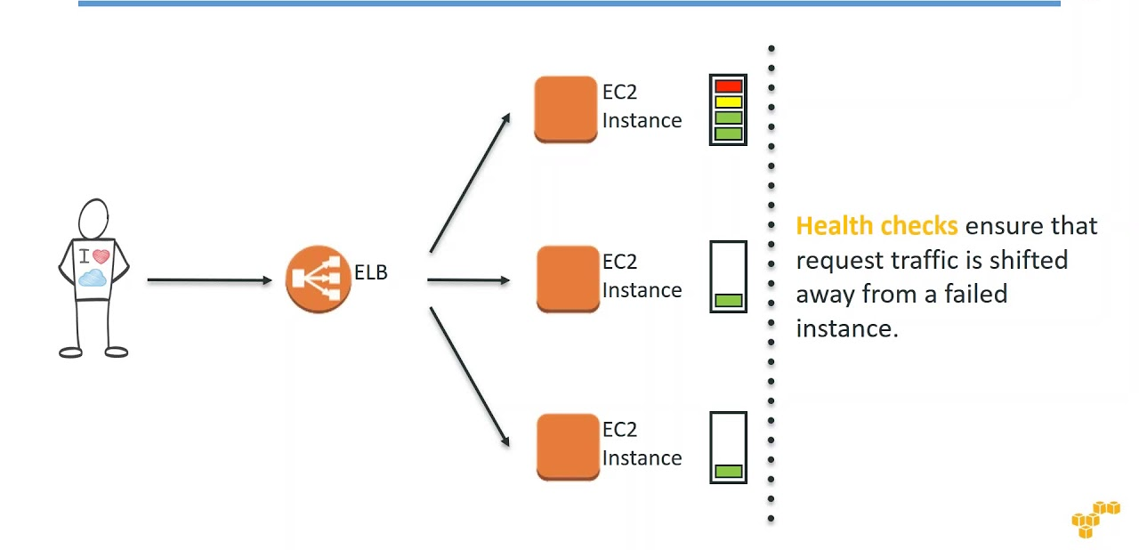
Health Checks

Slide 6
Types of load balancer on AWS
Classic Load Balancer ( v1 – old generation )
Application Load Balancer( v2 - new generation )
Network Load Balancer ( v2 - new generation )
Gateway Load Balancer

Slide 7
Classic Load Balancers (v1)
Supports TCP (Layer 4), HTTP & HTTPS (Layer 7)
Health checks are TCP or HTTP based
Fixed hostname XXX.region.elb.amazonaws.com

Slide 8
Application Load Balancer (v2)
Application load balancer is layer 7 (HTTP)
Load balancing to multiple HTTP application across machines(target group)
Load balancing to multiple applications on the same machine (Containers)
support for HTTP/2 and WebSocket
Support redirects (from HTTP to HTTPS for example)

Slide 9
ALB Routing
Based on path in URL ( example.com/users & example.com/posts)
Based on hostname in URL (one.example.com & other.example.com)
Routing based on query String, Headers (example.com/users?id=123)

Slide 10
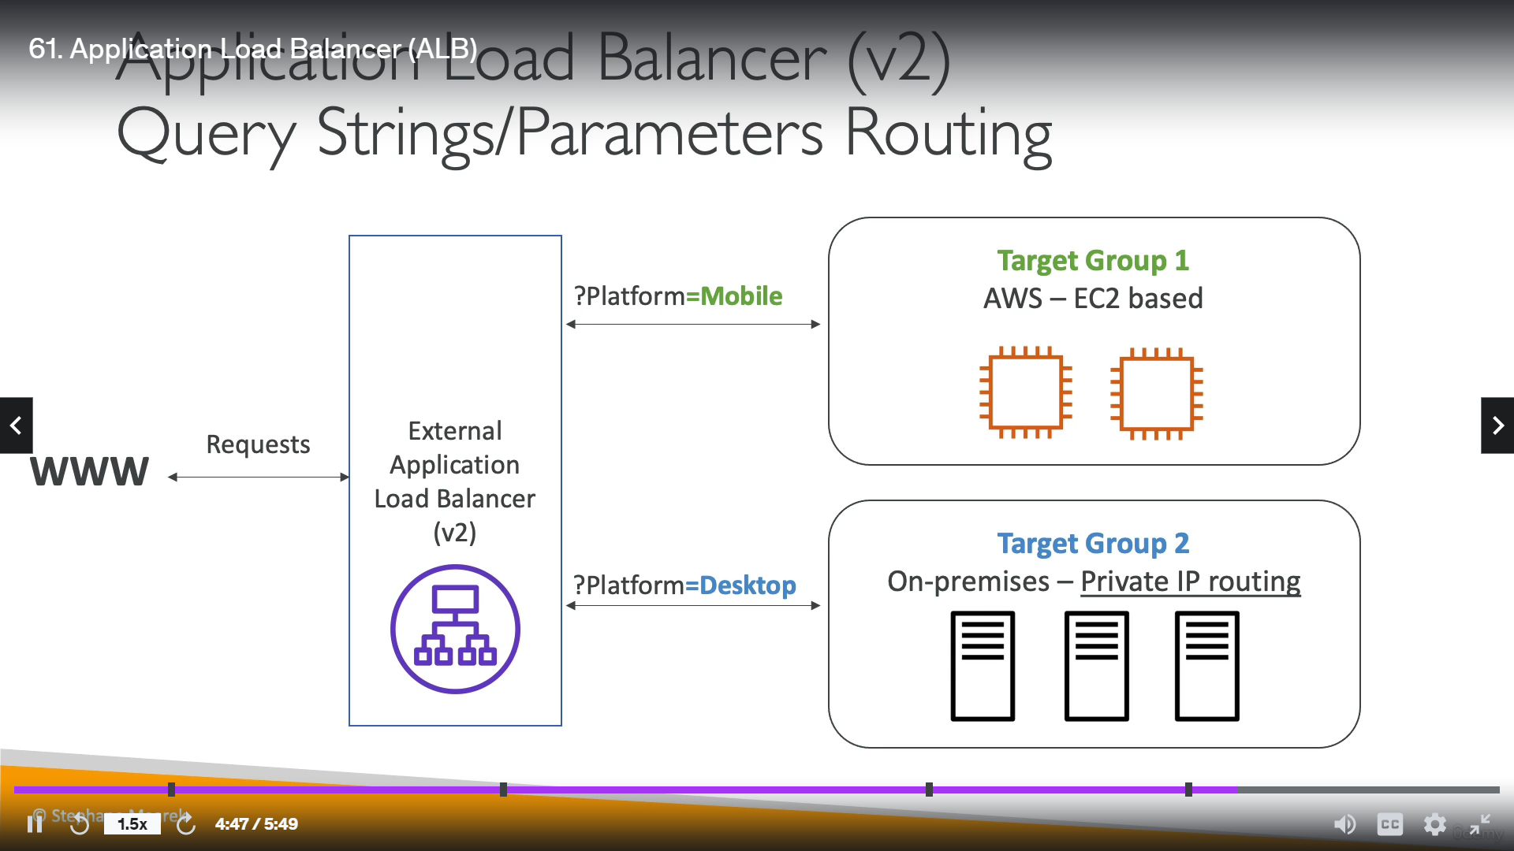
Application LB

Slide 11
Network Load Balancer (V2)
Forward TCP & UDP traffic to your instances
Handle millions of request per seconds
Less latency ~ 100 ms (vs 400 ms for ALB)
Not included in the AWS free tier

Slide 12
Gateway Load Balancer
Deploy, scale and manage a fleet of 3rd party netwok virtual appliances in AWS
Operates at Layer 3(Network Layer)
Uses the GENEVE protocol

Slide 13
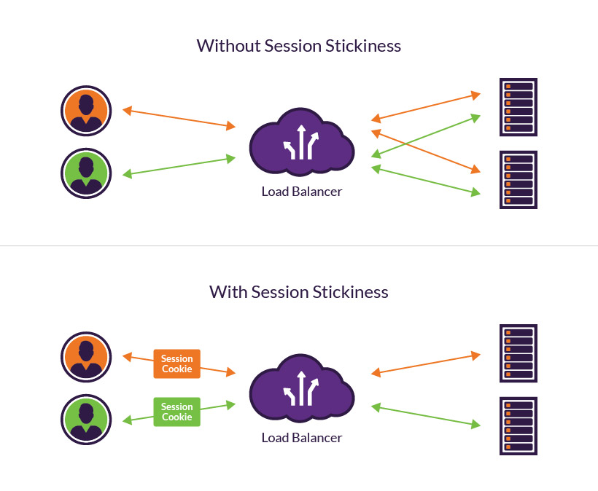

Slide 14
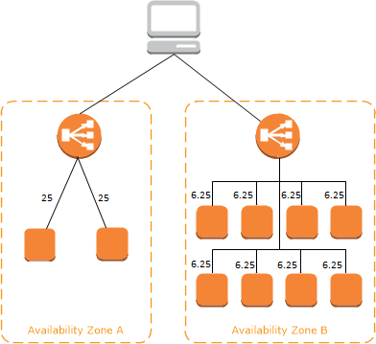
Cross zone load balancing disabled

Slide 15
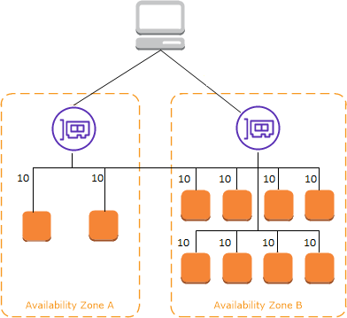
Cross zone load balancing enabled

Slide 16
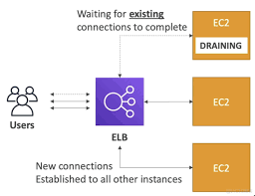
Connection Draining
Connection draining for – CLB
Deregistration delay for – ALB & NLB

Slide 17


